Slide 4
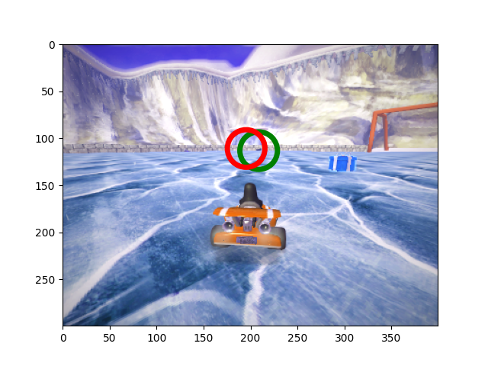
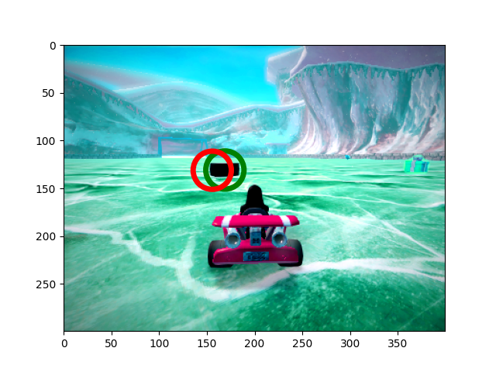
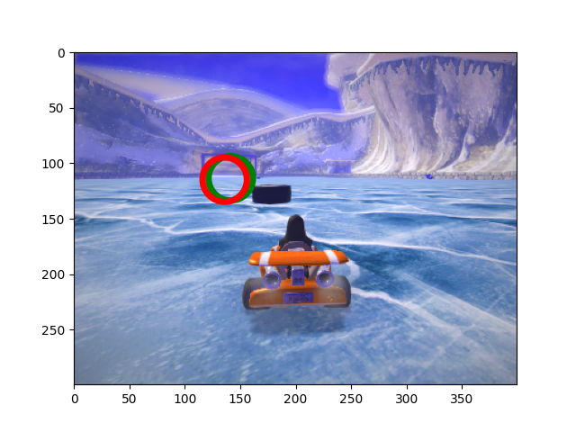
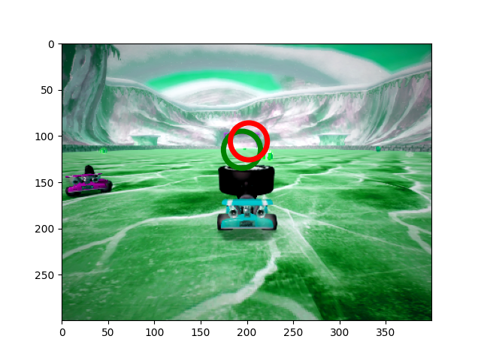
Puck Detector
Puck Detector
Goal Detector

Slide 5
Puck Detector
Puck Detector
Goal Detector

Slide 6
Puck Detector
Controller
Goal Detector

